Slide 1

Preprocessing Machine Learning Input Data with a Kalman Filter
Master Thesis Presentation
First Examiner: Prof. Dr. Andreas Pech
Second Examiner: Prof. Dr. Peter Nauth
Submitted by: Aiman Zehra
Matriculation number: 1388996

Slide 2
Contents
Introduction
Thesis Goal
General Structure of the System
Physical Experimental Work Setup
Dataset Acquisition
Software Setup
Kalman Filter Model Development
MLP Classification Model
Test Cases
Evaluation and Performance Analysis
Summary and Perspectives

Slide 3
Introduction
Human detection and Activity analysis play a pivotal role in variety of places, including human-computer interaction, security monitoring, assisted living, and person tracking, smart office buildings.
Building occupancy data is highly desired to boost the efficiency of energy management systems. Occupancy information in devices can be provided with high precision using multiple technologies.
The person detection system might automatically adjust settings related to lighting and temperature to make the environment more comfortable to work in. In short, person detection will not only translate into energy savings and enhanced security but also increased user comfort in office buildings.
In an office setting, a machine learning model can be utilized to improve human detection accuracy.

Slide 4
Thesis Goal
The objective is to optimize a classifier for person detection in an office environment. The goal is to use a Kalman filter to improve a machine-learning model (e.g. CNN, MLP, or SVM) that can accurately classify ultrasonic reflections from occupied and non-occupied office chairs.
Proper person detection within office spaces means we can better save energy, improve security, and create a more convenient environment for people to work in. Offices could optimize their energy usage with dynamic lighting per occupancy for potential savings.
By utilizing ultrasonic sensors and cutting-edge machine learning algorithms, this thesis seeks to solve the problem of optimizing a classifier for human detection in an office setting.
It aims to improve the stability, accuracy of detection system by implementing Kalman filter for eliminating noise and incorporating with a machine learning model for occupied chair detection.

Slide 5
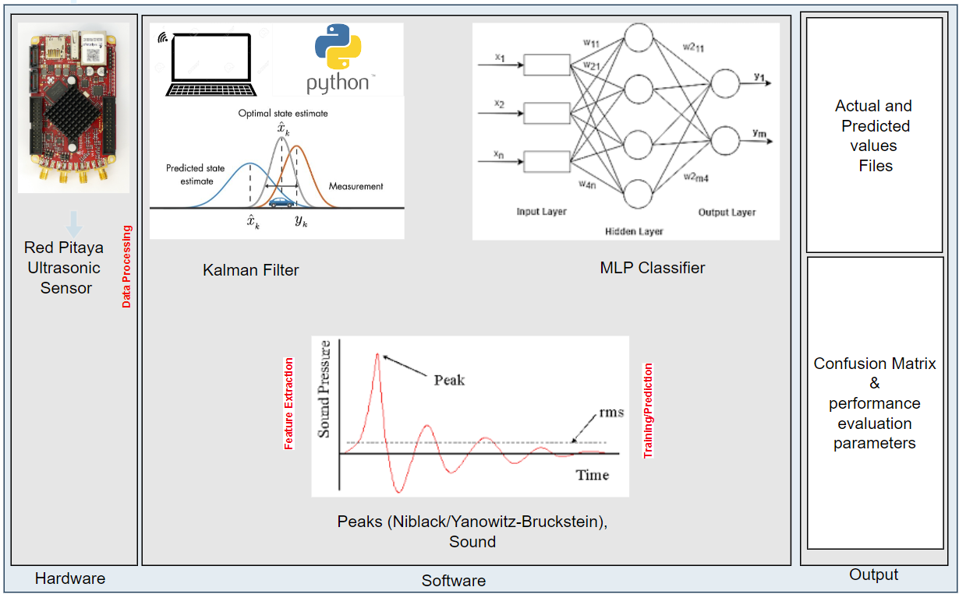
General Structure of the System
The system will have a set of components, namely, an ultrasonic sensor that collects the data, a Kalman filter to reduce noise and estimate sound pressure, and an MLP classifier that will classify the office chairs as occupied and non-occupied.

Slide 6
Physical Experimental Work Setup
To be sure that the data being provided by sensors was consistent, the experimentation activity was done under controlled lab conditions.
The sensor of Red Pitaya chip was placed at a chair level of approximately 1.5 m to collect accurate information.
The focal point of the arrangement was a chair that was positioned immediately underneath the sensor. The Red Pitaya is powered by connecting it to the power supply.

Slide 7
Dataset Acquisition
In this phase, the raw dataset is collected using the Red Pitaya sensor for four use cases.
Case 1: Non-Occupied (Empty chair):
Non-Occupied chair (Empty)
Non-Occupied chair (Chair with cardboard boxes kept on it)
Case 2: Occupied (Human):
Occupied chair (Human sitting idle on chair)
Occupied chair (Human sitting on a chair), Moving head/shaking hands, Different obstacles kept on office table

Slide 8
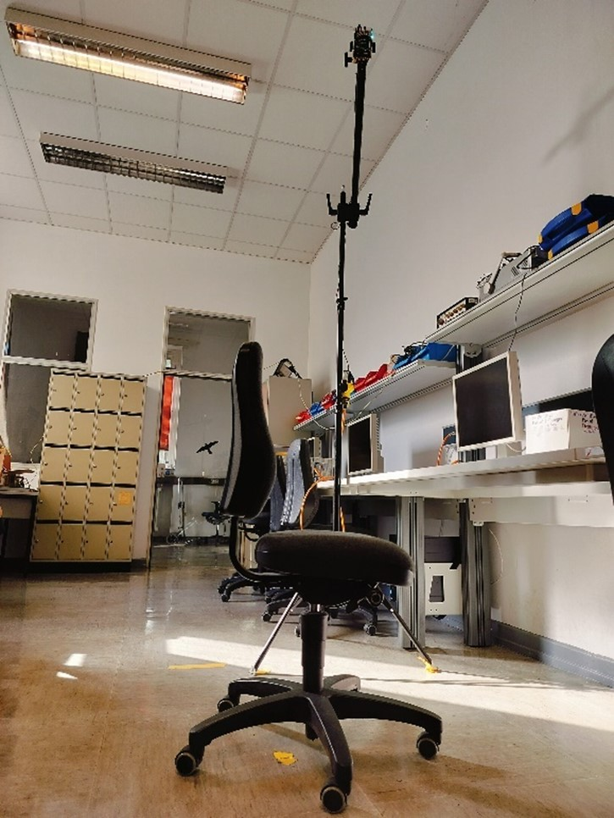
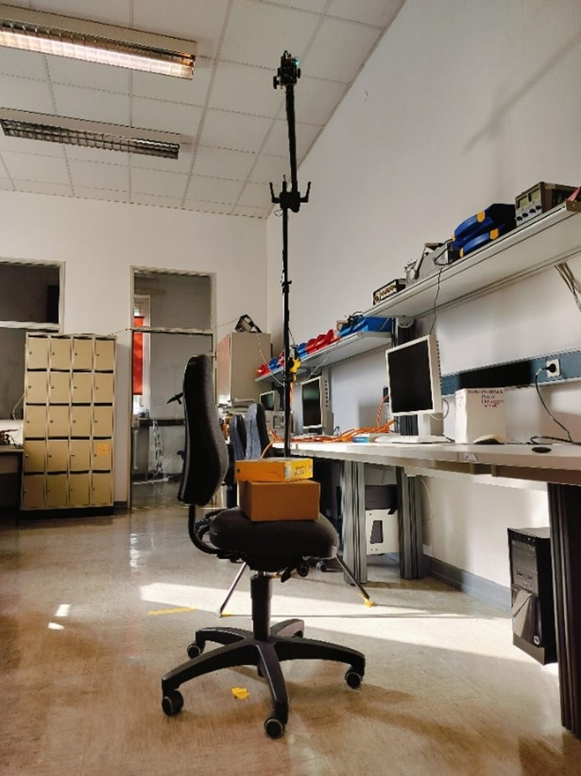
Dataset Acquisition Case 1: Non-Occupied (Empty chair)
Non-Occupied chair (Empty)
Non-Occupied chair (Chair with cardboard boxes kept on it)

Slide 9
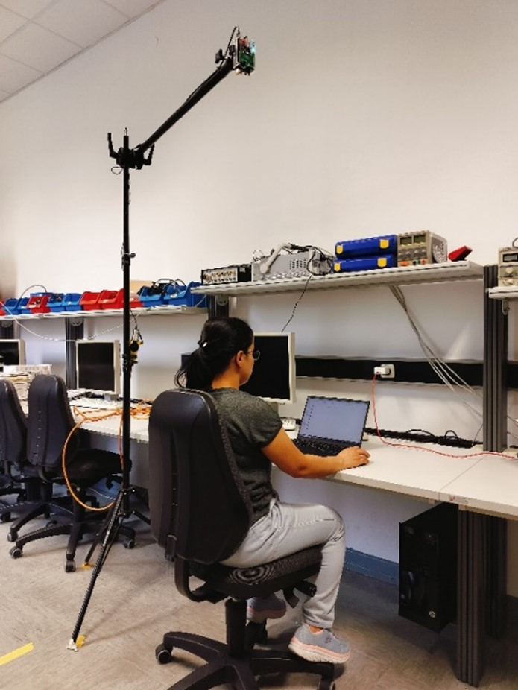
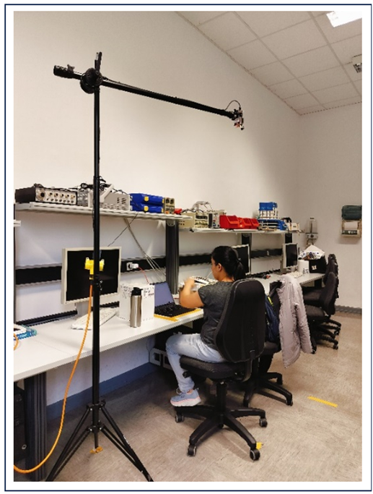
Dataset Acquisition Case 2: Occupied (Human)
Occupied chair (Human sitting on a chair), Moving head/shaking hands, Different obstacles kept on office table
Occupied chair (Human sitting idle on chair)

Slide 10
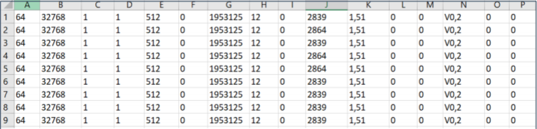
Software Setup
Setting up a Virtual Environment
A virtual environment was created to segregate the project from the globally installed version of Python.
The custom environment was created by using Python's built-in venv module. The virtual environment makes it easy for us to use and install only the essential libraries which are actually needed for the project and thus, all system libraries are no longer needed to be installed.
Removal of Headers from the Raw dataset
Created an extraction program whose main functionality is to remove the first 16 columns from the raw data, which is fed as an input file to this program.

Slide 11
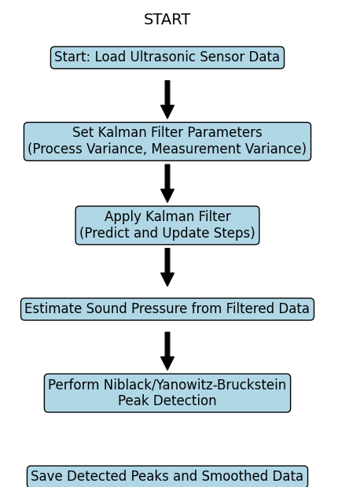
Kalman Filter Model Development

Slide 12
Kalman Filter Model Development
Noise suppression and sound pressure estimation
One of the most important issues when working with data from ultrasonic sensors is handling noise. To address the issue of noise, a Kalman filter is applied to the raw ultrasonic sensor data. A Kalman filter with state space model is used to smooth the raw ultrasonic signal.
1. Kalman Filter with State-Space Model
The Kalman filter is based on the state-space model which estimates three main variables: pressure, velocity, and acceleration.
2. Sound Pressure Estimation
Computes sound pressure using the speed of sound, air density, and calculated distance.

Slide 13
Kalman Filter Model Development
Niblack and Yanowitz Bruckstein peaks detection
Niblack and Yanowitz bruckstein thresholding methods detects peaks and save them in separate output files along with the 500 samples values before as well as after the point of peaks for each sample.
Signal Envelope in Kalman Filter Processing
Below steps were followed up for the implementation:
Peak Detection
Interpolation
Envelope Visualization

Slide 14
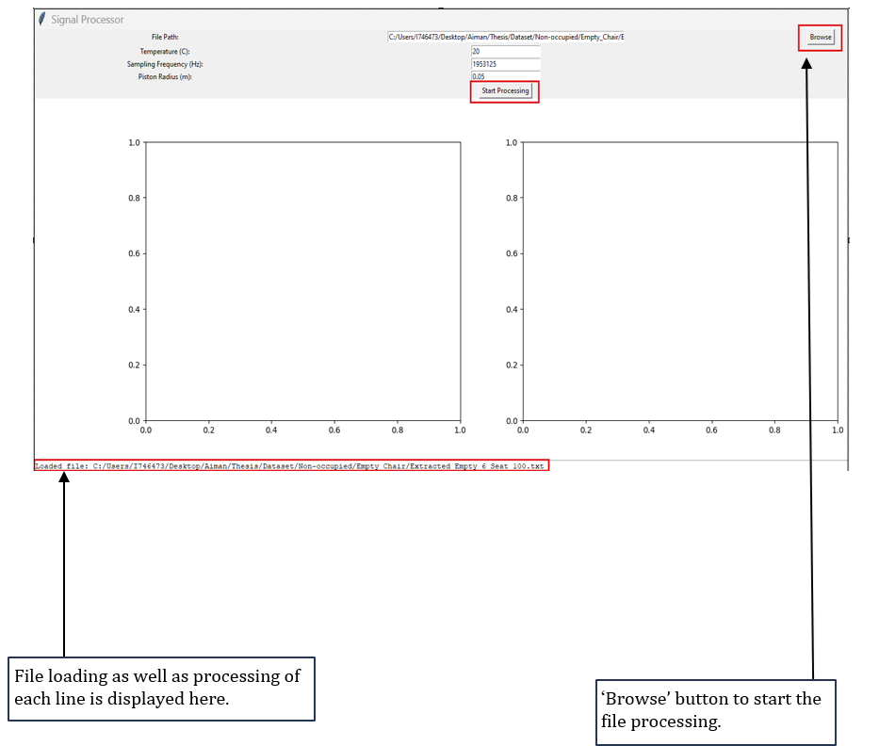
Kalman Filter Model Development
GUI for visualization

Slide 15
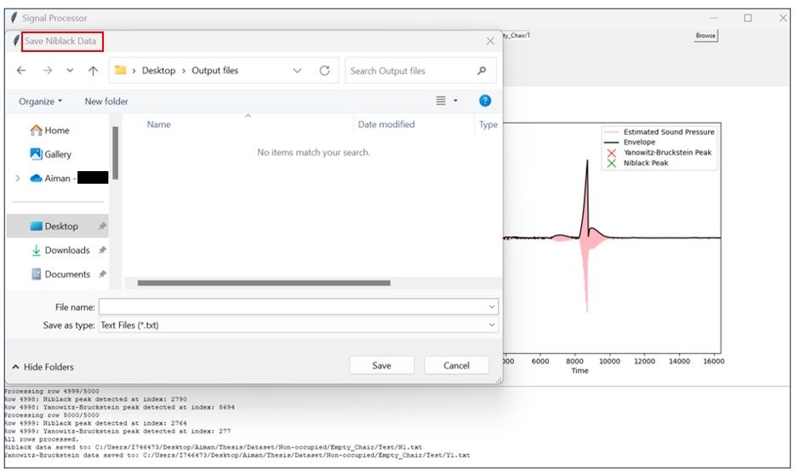
Kalman Filter Model Development
GUI to save the Niblack peak data after the Kalman Filter processing.

Slide 16
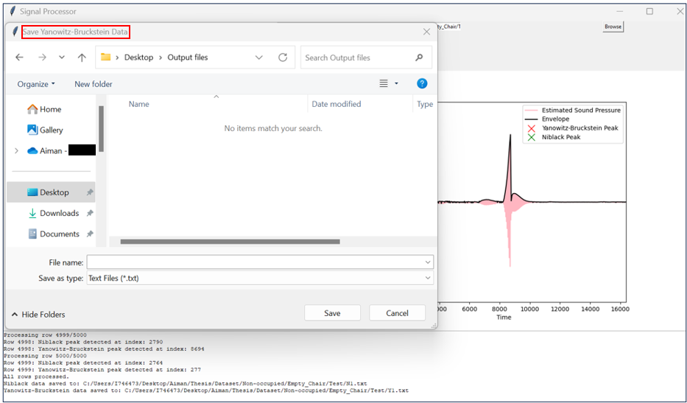
Kalman Filter Model Development
GUI to save the Yanowitz peak data after the Kalman Filter processing.

Slide 17
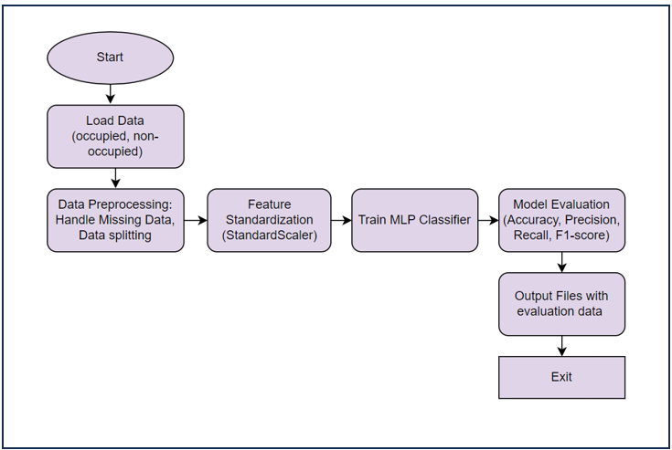
MLP Classification Model

Slide 18
MLP Classification Model
Input Data and Preparation - After raw ultrasonic data is filtered using the Kalman filter and peak detection, two files are generated namely Niblack_Peak.txt and Yanowitz_Peak.txt.
Feature Standardization - The features are to be normalized before the training of the MLP classifier. StandardScaler scales features so that their mean would be 0 and standard deviation 1.
Design and Training - The proposed classifier will be trained using the labeled dataset. Backpropagation and gradient descent shall be used for a maximum of 30,000 iterations with an assurance of sufficient model convergence.
Model Testing and Evaluation - After training the classifier, test sets were used to check the performance of the trained classifier.
Saving and Exporting Model Results - Finally, the results of the classifier are saved for future analysis.

Slide 19
Test Cases
Cases | Conditions
Case I | Non-Occupied chair (Empty) vs. Occupied chair (Human idle)
Case II | Non-Occupied chair (Boxes) vs. Occupied chair (Human idle)
Case III | Non-Occupied chair (Empty) vs Occupied chair (Human moving)
Case IV | Non-Occupied chair (Boxes) vs. Occupied chair (Human moving)

Slide 20
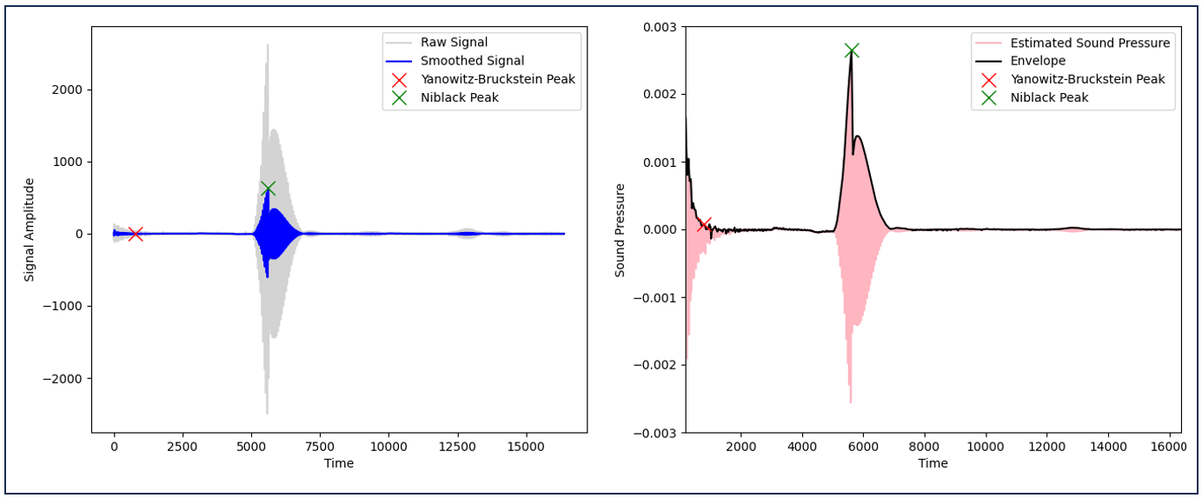
Evaluation and Performance Analysis
Noise reduction Analysis
Analysis of occupied dataset

Slide 21
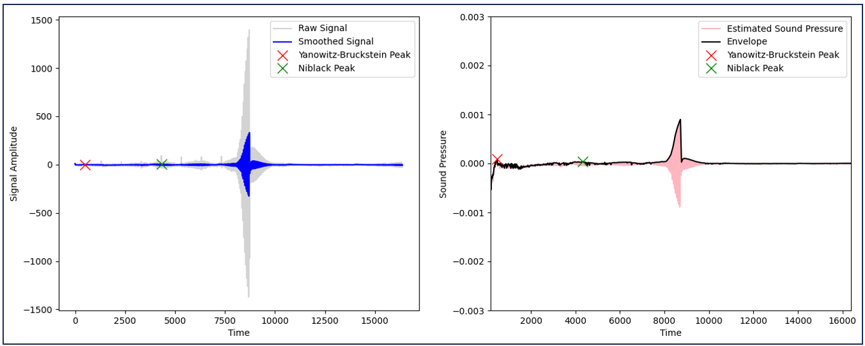
Evaluation and Performance Analysis
Noise reduction Analysis
Analysis of Non-Occupied dataset

Slide 22
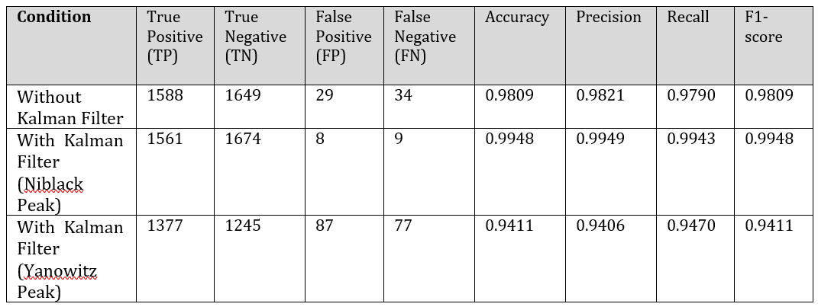
Evaluation and Performance Analysis
Impact of Kalman Filter on Classification
Case 1: Non-Occupied chair (Empty) vs. Occupied chair (Human idle)

Slide 23
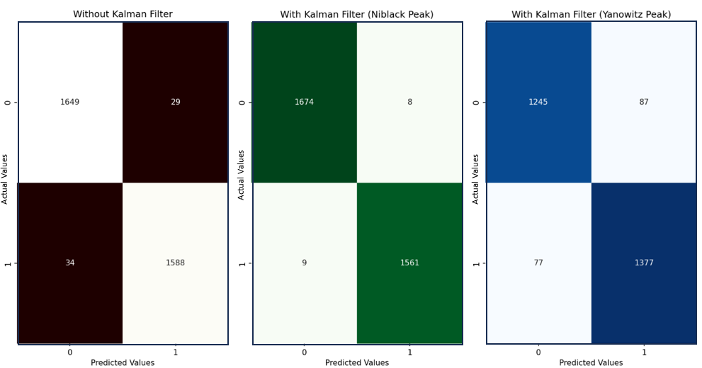
Evaluation and Performance Analysis
Impact of Kalman Filter on Classification
Case 1: Non-Occupied chair (Empty) vs. Occupied chair (Human idle)
Confusion matrix
for case I

Slide 24
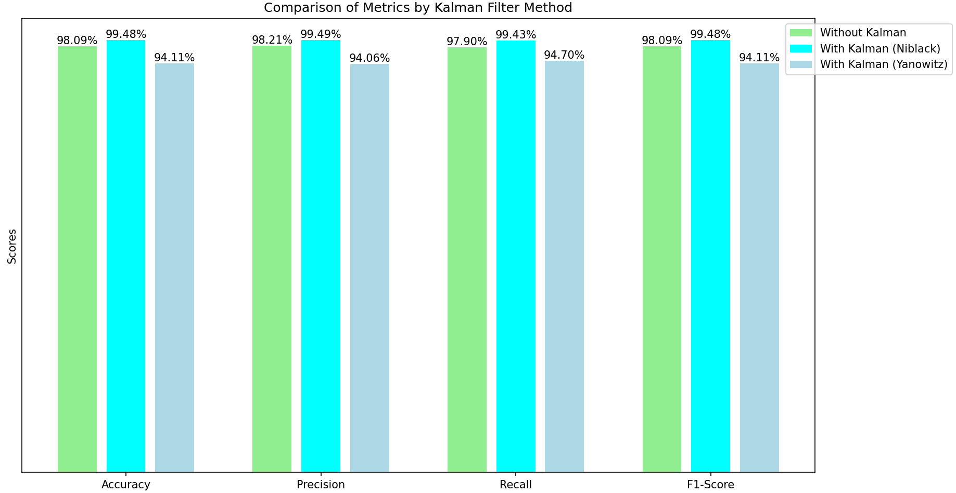
Evaluation and Performance Analysis
Impact of Kalman Filter on Classification
Case 1: Non-Occupied chair (Empty) vs. Occupied chair (Human idle)
Bar chart for
the comparison
of matrices for case I

Slide 25
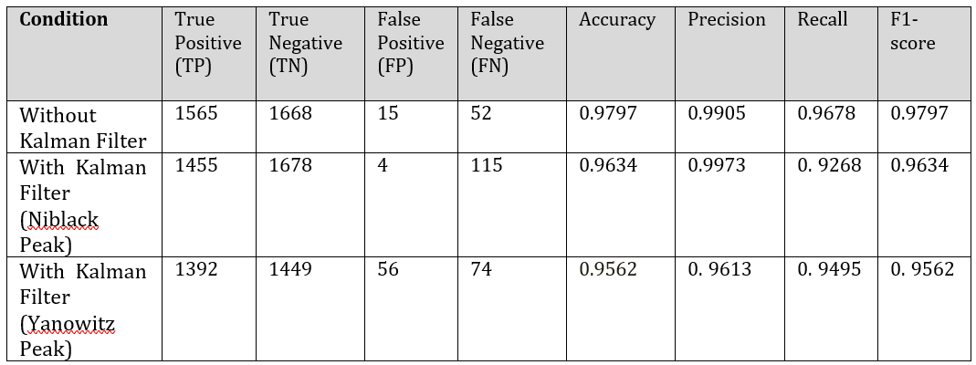
Evaluation and Performance Analysis
Impact of Kalman Filter on Classification
Case 2: Non-Occupied chair (Boxes) vs. Occupied chair (Human idle)

Slide 26
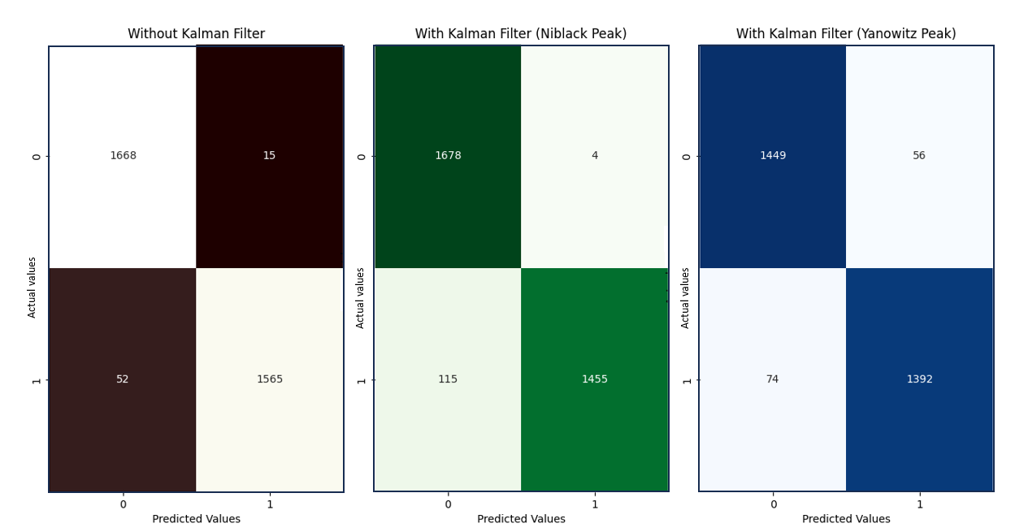
Evaluation and Performance Analysis
Impact of Kalman Filter on Classification
Case 2: Non-Occupied chair (Boxes) vs. Occupied chair (Human idle)
Confusion matrix
for case II

Slide 27
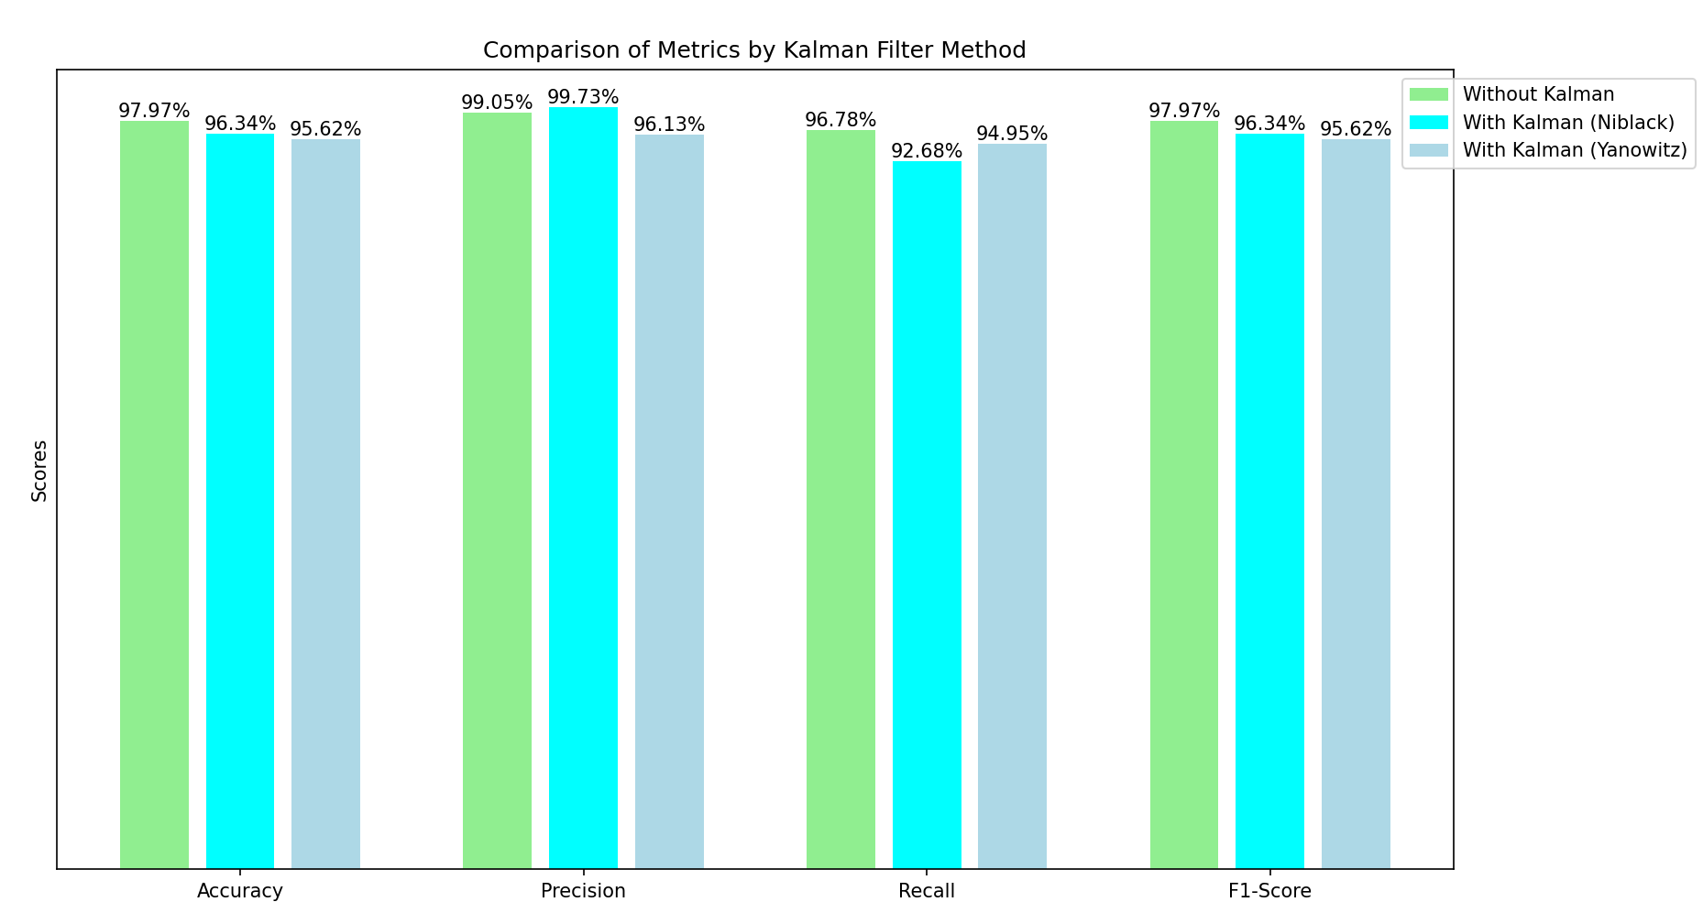
Evaluation and Performance Analysis
Impact of Kalman Filter on Classification
Case 2: Non-Occupied chair (Boxes) vs. Occupied chair (Human idle)
Bar chart for
the comparison
of matrices for case II

Slide 28
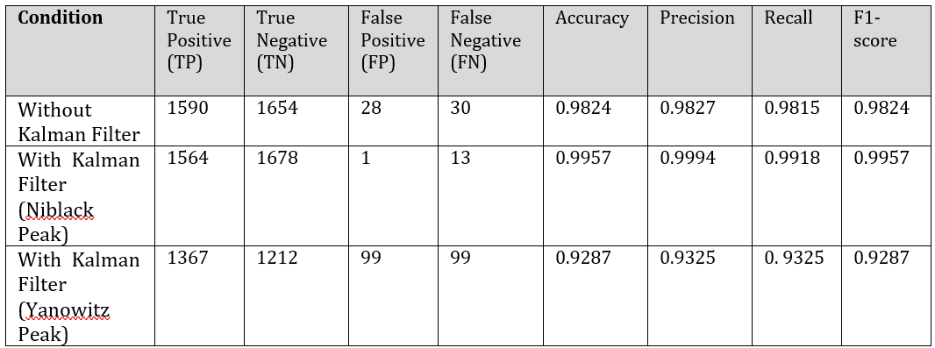
Evaluation and Performance Analysis
Impact of Kalman Filter on Classification
Case 3: Non-Occupied chair (Empty) vs Occupied chair (Human moving)

Slide 29
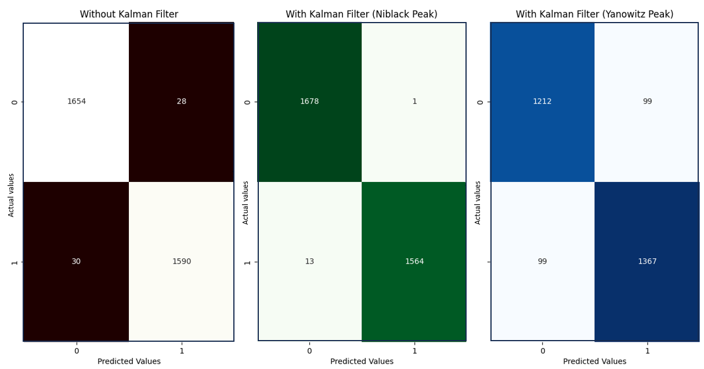
Evaluation and Performance Analysis
Impact of Kalman Filter on Classification
Case 3: Non-Occupied chair (Empty) vs Occupied chair (Human moving)
Confusion matrix
for case III

Slide 30
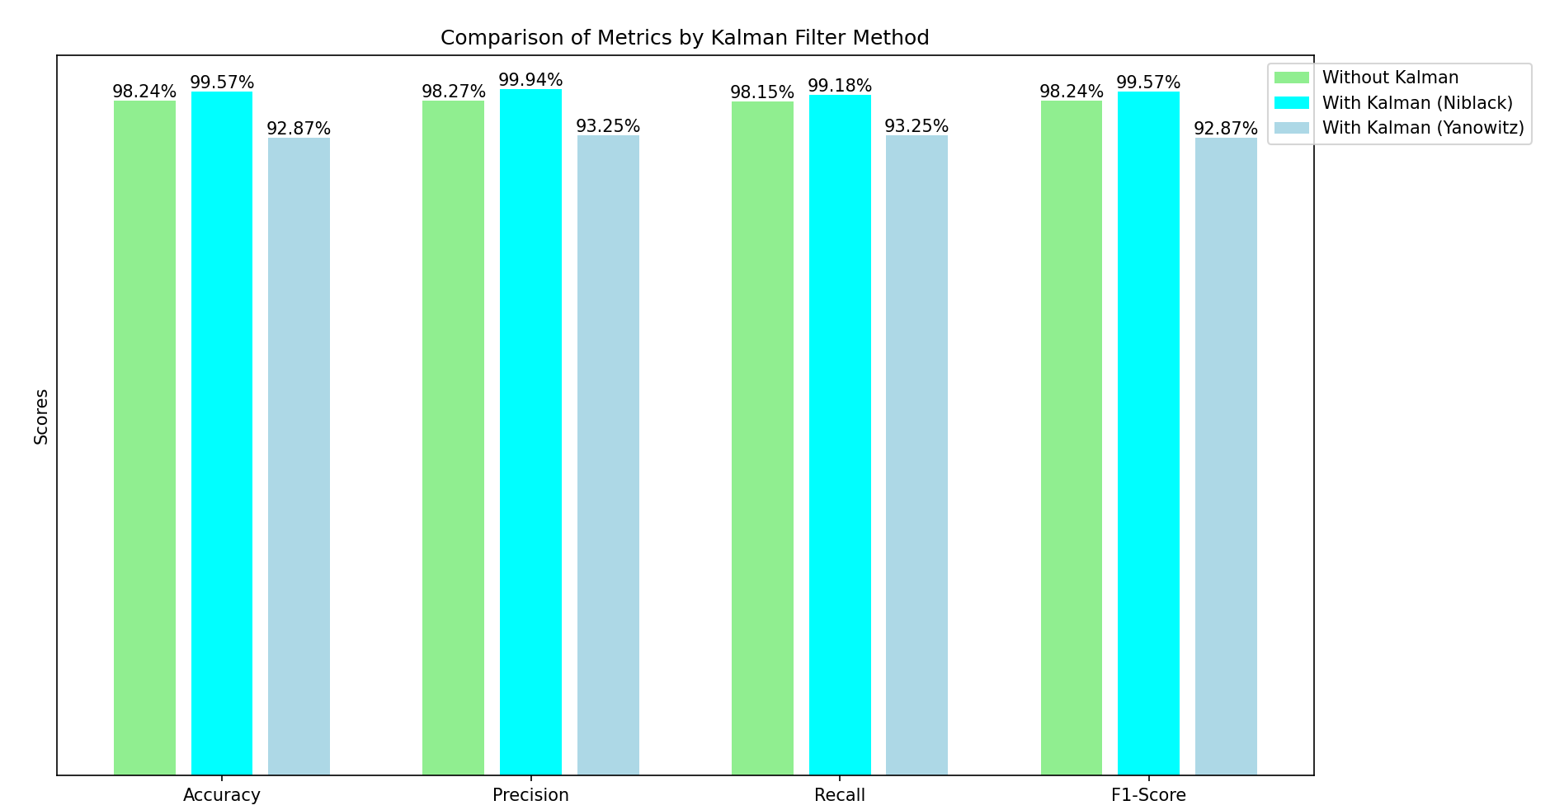
Evaluation and Performance Analysis
Impact of Kalman Filter on Classification
Case 3: Non-Occupied chair (Empty) vs Occupied chair (Human moving)
Bar chart for the
comparison of
matrices for case III

Slide 31
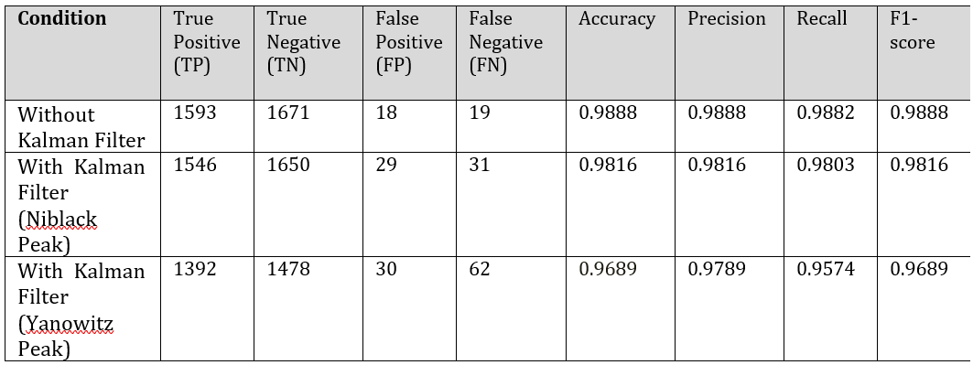
Evaluation and Performance Analysis
Impact of Kalman Filter on Classification
Case 4: Non-Occupied chair (Boxes) vs. Occupied chair (Human moving)

Slide 32
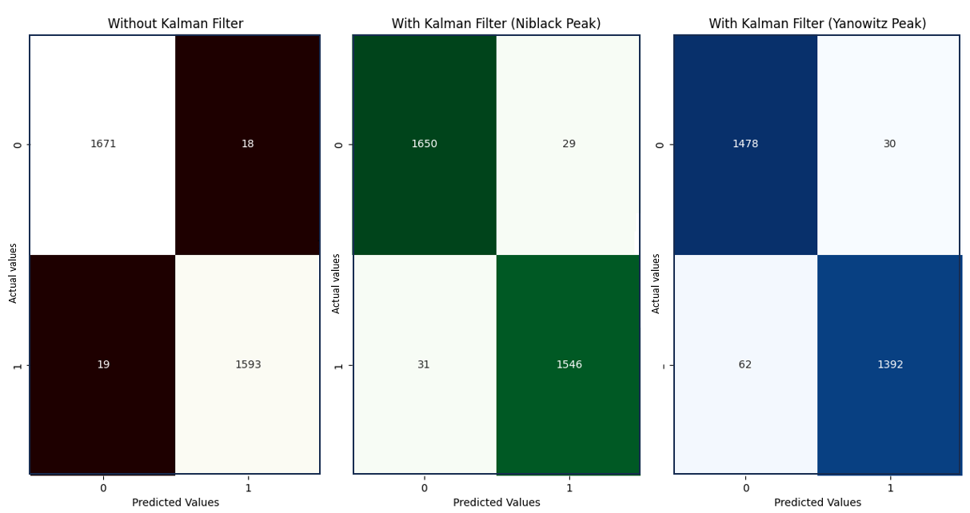
Evaluation and Performance Analysis
Impact of Kalman Filter on Classification
Case 4: Non-Occupied chair (Boxes) vs. Occupied chair (Human moving)
Confusion matrix
for case IV

Slide 33
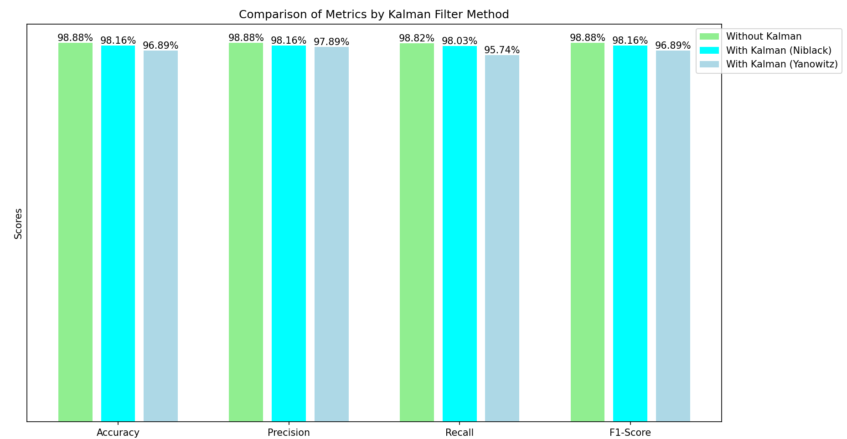
Evaluation and Performance Analysis
Impact of Kalman Filter on Classification
Case 4: Non-Occupied chair (Boxes) vs. Occupied chair (Human moving)
Bar chart for the
comparison of
matrices for case IV

Slide 34
Evaluation and Performance Analysis
Comparative Performance Analysis
Effectiveness of Kalman Filtering - Indeed, as can be seen by generally higher precision scores in all cases, Kalman filter application-both with Niblack and Yanowitz peaks-improved results by reducing noise.
Comparative Analysis of Niblack vs. Yanowitz Peak Detection - Overall, the peaks of Niblack tended to report higher accuracy, precision, and recall in case an idle human being exists. Yanowitz peaks were undetermined, as both the accuracy and recall became lower in more dynamic cases such as Case 3 and Case 4.
Performance Metrics Evaluation
Accuracy Analysis: The Accuracy for the classifier showed a significant improvement with Kalman filter, especially in the cases of Niblack peak detection.
Precision Analysis: Precision results also showed that using a Kalman filter proved to be useful, particularly when applied with the Niblack peak detection method.
F1-score: The F1-score is a balance between precision and recall, and its maximum value was reached using the Kalman filter together with Niblack peak detection.

Slide 35
Summary and Perspectives
This study showcased the Performance metrics results which reveals that Kalman filter combined with Niblack peak gives a balanced approach in the minimization of false positives and missed detections across various cases.
On the other hand, the Yanowitz peak method improved classification accuracy, as compared to raw data, but its results varied for dynamic environments, hence requiring adaptable peak detection strategies when ultrasonic sensors are used for real-time applications such as detection of person in an office environment.

Slide 36
THANK YOU

